Slide 1
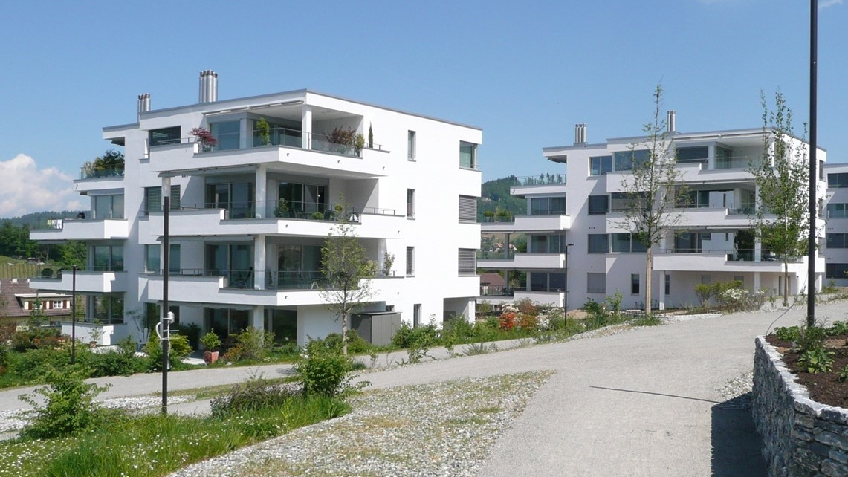

Modelling biocides release from buildings to the environment using COMLEAM
Michael Burkhardt*, Mirko Rohr*, Michael Patrick*, Silvan Gehrig, Olaf Tietje
Eastern Switzerland University of Applied Sciences,
*Institute of Environmental and Process Engineering (UMTEC),
8640 Rapperswil, Switzerland
Online, 4 May 2021

Slide 2
Focus of the Presentation
Overview to leaching of biocides
Challenges regarding environmental exposure
Scenario derived for risk communication
Insight to Software COMLEAM (www.comleam.ch)

Slide 3
Outline
Introduction
Façade Coatings
Risk Scenario
Summary (Q&A)
COMLEAM-Software
Exercises (Q&A)

Slide 4
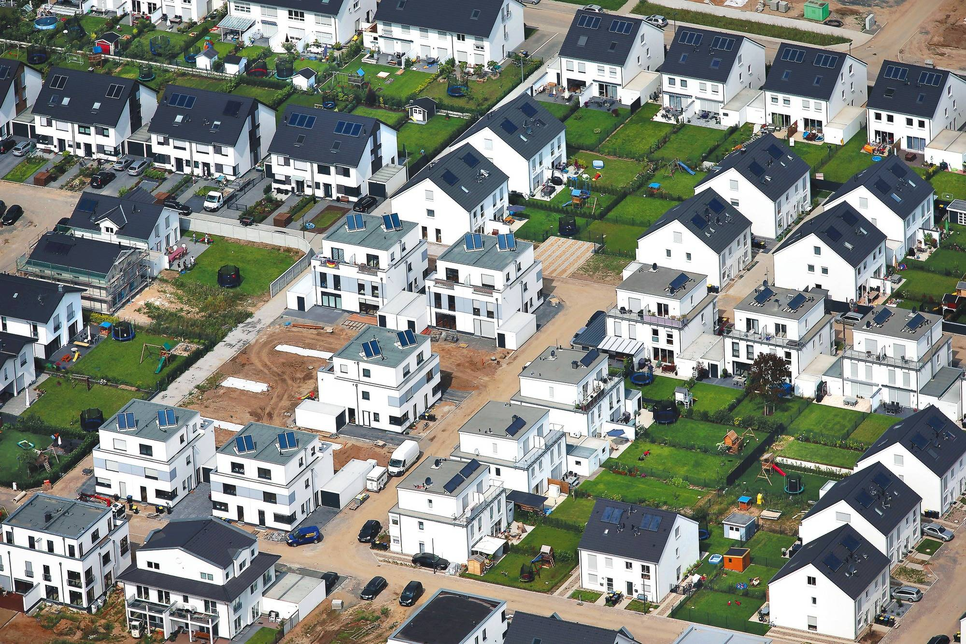
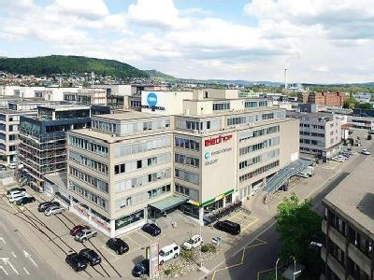
Introduction – Built Environment
Different types of architectural designs – height, structure, orientation etc.
www.rnz.de/nachrichten/bergstrasse_artikel,-Bergstrasse-16-Haeuser-in-Altenbacher-Neubaugebiet-geplant-_arid,229891.html

Slide 5
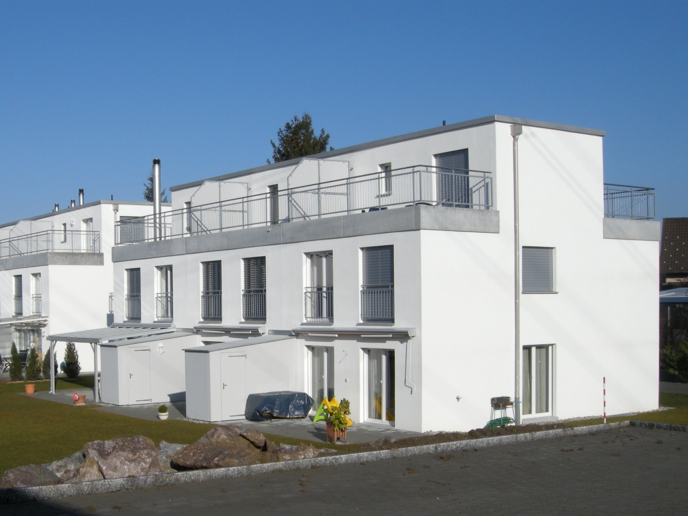
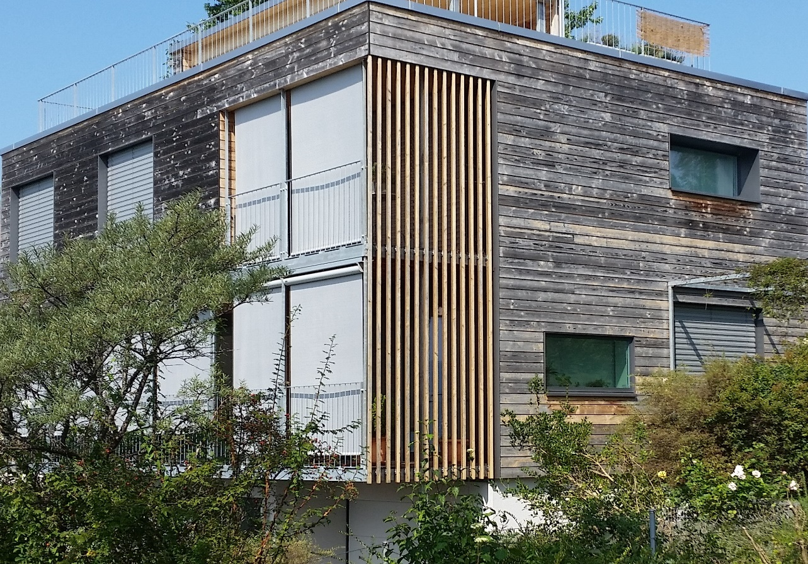
Introduction – Buildings
Different construction products – render, paint, metal, coated metals, etc.

Slide 6
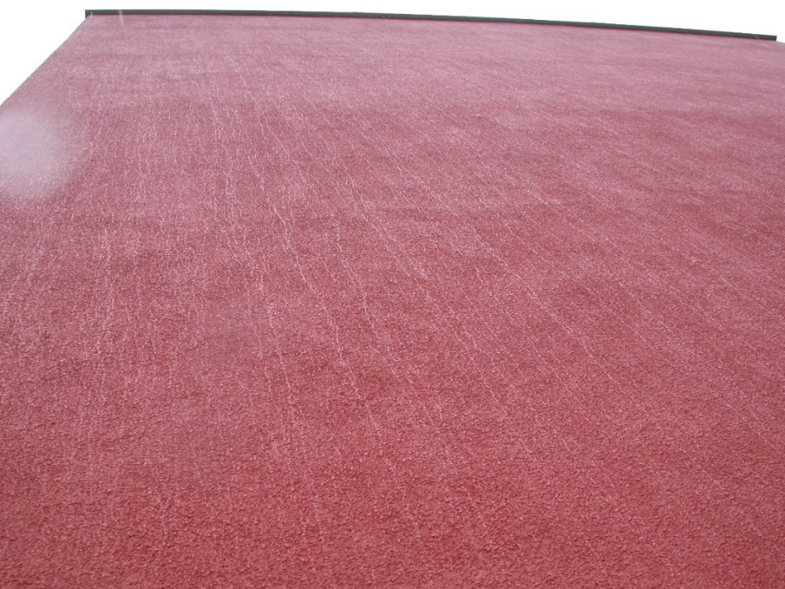
Introduction – Leaching
Varying release into water (= loss of materials performance)
  Substance and material properties (= specific product)
  Weather conditions (precipitation, condensation, temperature, UV-irradiation etc.)
  Wind driven rain at vertical components (orientation, wind)
Transport in material
(product & weather)
Leaching into water
(weather & orientation)
In the material:
Moisture = Transport
At the material surface:
Rainfall = Leaching
(No Rainfall = No Leaching)
Moisture
Rainfall / wind driven rain
Condensation, runoff etc.
Substance
Leaching / wash-off
Transformation etc.

Slide 7
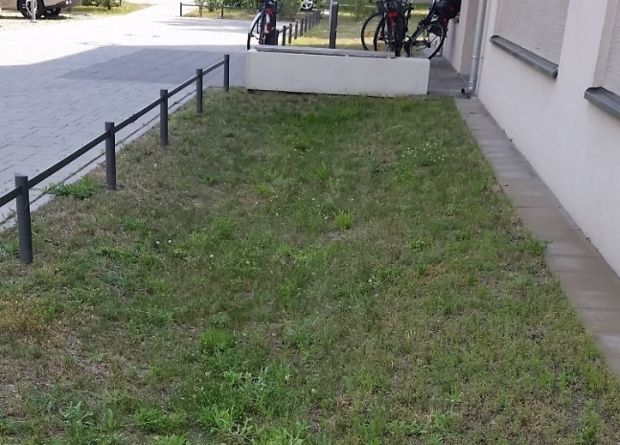
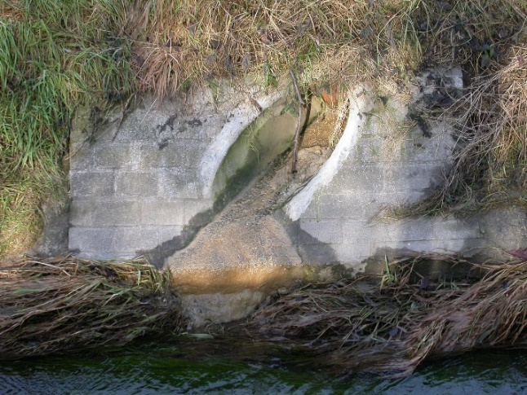
Introduction – Environmental Exposure
Diffuse emissions house/city to soil and aquatic systems
  Stormwater infiltration to soil and groundwater
  Separated discharge to surface water
Infiltration
Direct Discharge

Slide 8
Outline
Introduction
Façade Coatings
Risk Scenario
Summary
COMLEAM-Software
Exercises

Slide 9
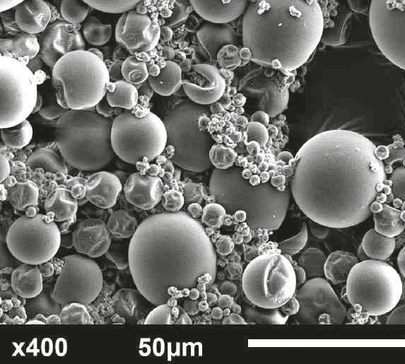
Façade Coatings – Preservatives used in Polymeric Coatings
Biocides used in paints/renders (PT7): 250-400 t/a (Germany)
  2 - 4 biocides in combination, each with 500-6000 mg/m²
  Encapsulated biocides >75 % market share (Germany)
Substance Class | Biocide | PNEC*¹ (ng/L) | Solubility³ (mg/L) | logPow³ | Persistence
Triazine | Terbutryn | 34 | 22 | 3.7 | high
Phenylurea | Diuron | 20 | 35 | 2.7 | high
 | Isoproturon | 200² | 70 | 2.5 | high
Isothiazolinone | DCOIT | 8 | 14 | 4.9 | low
 | OIT | 13 | 480 | 2.4 | low
Carbamate | IPBC | 26 | 168 | 2.4 | low
 | Carbendazim | 34 | 8 | 1.6 | medium
Metal organic | Zinc pyrithione | 3 | 8 | 0.9 | low
* PNEC: Predicted No Effect Concentration for aquatic organisms (algae)
1 Burkhardt, et al. (2016): Biozidprodukte – Eintrag in Gewässer. Aqua und Gas, 4: 46-54. ; 2 Gartiser et al. (2015): Reduction of environmental risks from the use of biocides. Report, UBA, Dessau-Rosslau.
3 Vermeirssen et al. (2017): Corrosion protection products as a source of bisphenol A and toxicity to the aquatic environment. Wat. Res., 123:586-593

Slide 10
Façade Coatings – Leaching Behaviour in the Laboratory
Immersion test with polymeric renders (EN16105): 3 products, 2 biocides, encapsulated
  Rapid release at the beginning and often nearly constant afterwards
  Variability of leaching factor 2–5 by formulation (binder, pigment-volume concentration)
  Variability of leaching factor 2–3 by substance (logPow)
log Partitioning Octanol/Water (-)
1 Wicke, D. et al. (2021): Bauen und Sanieren als Schadstoffquelle in der urbanen Umwelt. Bericht, UBA, Dessau-Rosslau.

Slide 11
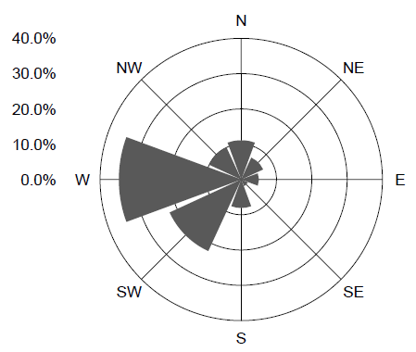
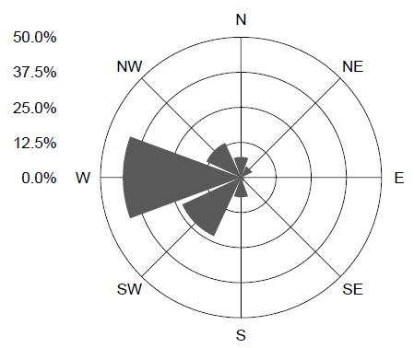
Façade Coatings – Wind Driven Rain in the Field
Runoff by Wind Driven Rain (ISO 15927-3:2009) with < 5 % of precipitation
  Orientation: up to 50 % of runoff at West Facade
  Site specific conditions relevant (shading etc.)
  Less important is the region (Berlin, Munich etc.)
West, building heights 20 m
Berlin
Munich
East, building heights 20 m
1 Wicke, D. et al. (2021): Bauen und Sanieren als Schadstoffquelle in der urbanen Umwelt. Bericht, UBA, Dessau-Rosslau.

Slide 12
Façade Coatings – Leaching under Field Conditions
Rapid release and huge variability between events (non-linear emission)
  Variability due to weather conditions (dry-wet cycles etc.)
  Degradation by UV-irradiation (transformation products occur)
  Similar pattern to the laboratory, but different losses (amount of water very different)
West facade, 6 m height
loss 1.5 % Terbutryn in 620 d

Slide 13
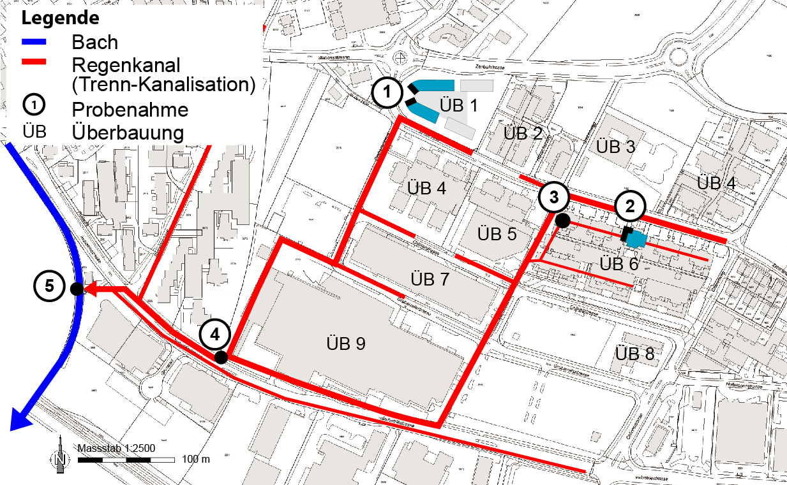
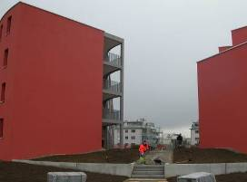
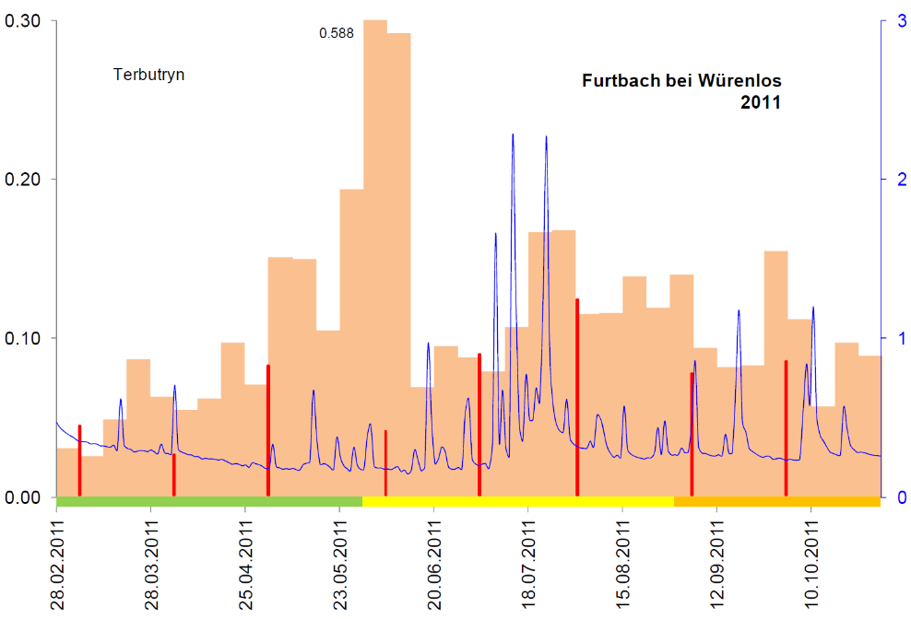
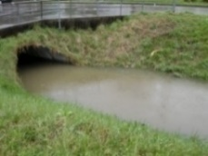
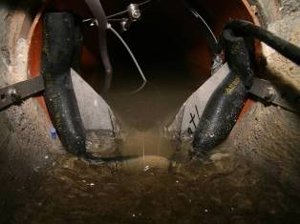
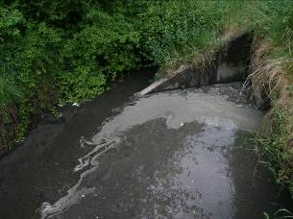
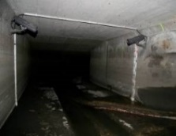
Façade Coatings – Emissions and Environmental Exposure
Peak pollution in stormwater runoff (event-based) and surface waters (composite samples)
  Occurrence during wet weather flow by diffuse discharge (coatings)
  Relevant for aquatic organisms and water quality (limit values, acute and chronic)
Event-based mean concentrations in stormwater (n=20)
Weekly/monthly mean concentrations in streamflow
Legend
Brook
Stormwater
1 Sampling site
ÜB Buildings
470 μg/L
(max. 770)
Terbutryn
Small brook
4
0.02 μg/L
(max. 0.27)
1
Flow (m³/s)
Concentration (μg/L)
3
2
  WFD EQS
  0.065 µg/l
0.05 μg/L
(max. 0.14)
0.3 m
0.3 μg/L
(max. 1.8)
1.6 m
0.07 μg/L
(max. 0.31)
2.4 m
Burkhardt, M., et al. (2011): Leaching of additives from construction materials to urban storm water runoff. Water Science & Technology, 63(9):1974-1981
Sinniger et al. (2012>): Pestiziduntersuchung, AWEL, Zürich.

Slide 14
Outline
Introduction
Façade Coatings
Risk Scenario
Summary
COMLEAM-Software
Exercises

Slide 15
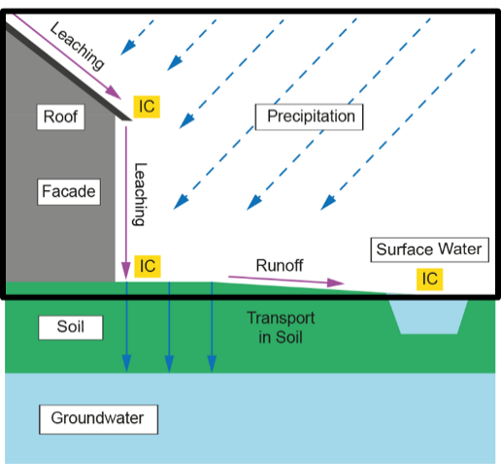
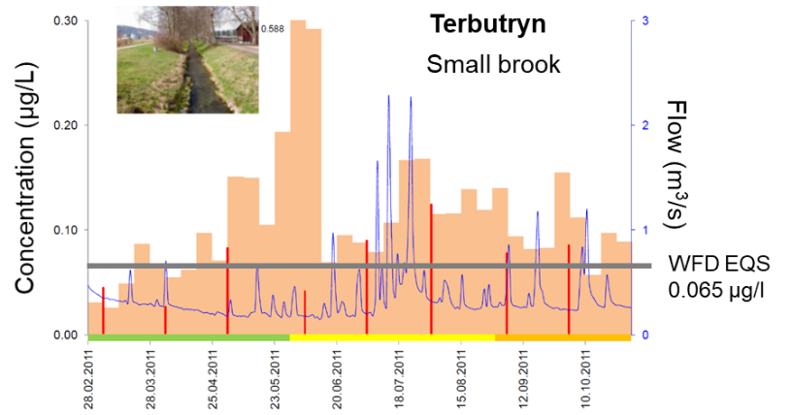

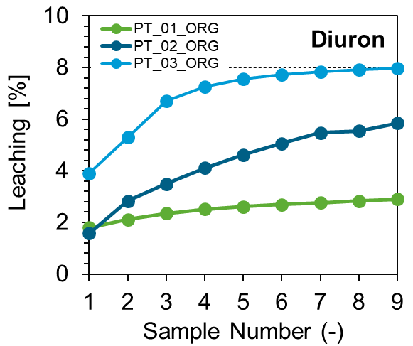


Risk Scenario: Assessment of Emissions using an Exposure Scenario in Switzerland
Environmental impact of construction products to surface waters^{1,2}
  Emission: Persistence, ecotoxicity and leaching data of products (EN 16105, CEN/TS16637-2)
  Modelling an exposure scenario: Weather, geometry, flow in surface waters, limit values etc.
  Risk evaluation: PEC / PNEC criteria classified leading to declaration
Assessment of Soil and Groundwater also possible (PELMO, M. Klein)
Emission
(lab, field)
Modelling
(Software COMLEAM)
Environmental Impact
(surface water, groundwater)
Declaration
(e.g. product label)
1 Burkhardt, M. et al. (2021): Emissionsbasierte Bauproduktebewertung – Gewässerschutz an der Quelle. Aqua und Gas, 55-64.
2 Burkhardt, M. et al. (2021): Entwicklung einer emissionsbasierten Bauproduktebewertung - Anwendung des Konzepts für Dachbahnen und Fassadenputze. Report, p. 115

Slide 16

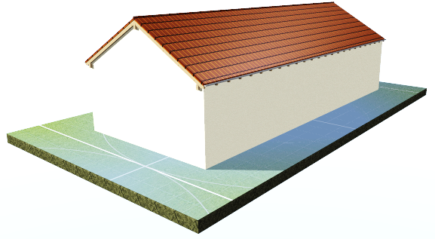
Risk Scenario: Exposure Scenario for Façade Render – Certain Boundary Conditions
Geometry and exposure in the CH scenario (single house ≈ ESD countryside scenario)
  Height 10 m typical for 3-storey building
  Area of dilution 400 m² (representing pavements etc.)
  W- and E-façades orientation at long side
  Flat roof 145 m² (similar size as BPR)
Hourly direct
discharge
Streamflow
5 L/s
10 m
17.5 m
7.5 m
5 m
28.5 m
17.5 m

Slide 17
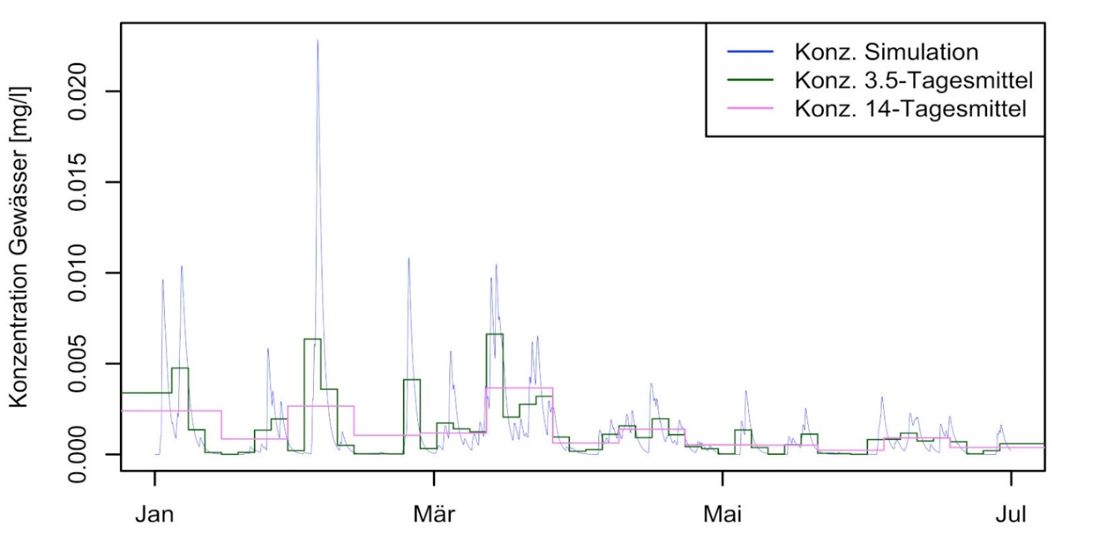
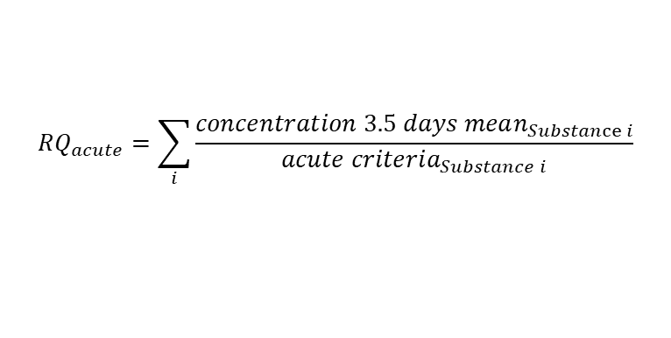
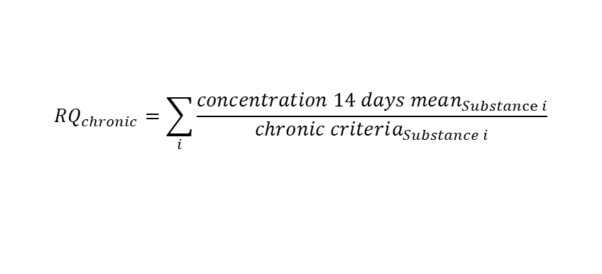
Risk Scenario: Risk Assessment using Limit Values
Predicted emissions and surface water concentrations
  Simulation period: 5 years of service life (weather data from Zurich, 1100 mm/a)
  PEC/ PNEC ratios for acute (3.5 d) and chronic values (14 d) calculated
  Classification of temporal proportion above criteria
Conc. Simulation
Conc. 2.5 days mean
Conc. 14 days mean
$$RQ_{acute}=\sum_{i}{\frac{concentration 3.5 days mean_{Substance i}}{acute criteria_{Substance i}}}$$
Concentration (mg/L)
$$RQ_{chronic}=\sum_{i}{\frac{concentration 14 days mean_{Substance i}}{chronic criteria_{Substance i}}}$$
Simulation Time
Burkhardt, M. et al. (2021): Entwicklung einer emissionsbasierten Bauproduktebewertung - Anwendung des Konzepts für Dachbahnen und Fassadenputze. Report, p. 115

Slide 18
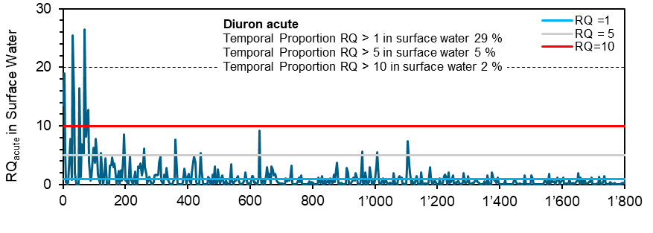
Risk Scenario: Acute Risk in Surface Water
Predicted acute concentration in surface water
  Three acceptance levels defined (RQ 1, 5, 10) related to classes
  Typical polymeric coatings do not fulfil criteria of best class (except using IPBC, OIT, DCOIT)
Concept has been implemented by eco-bau (Feb 2021; www.ecobau.ch)
RQ_{acute} in Surface Water
Simulation Time
Burkhardt, M. et al. (2021): Emissionsbasierte Bauproduktebewertung – Gewässerschutz an der Quelle. Aqua und Gas, 55-64.

Slide 19
Outline
Introduction
Façade Coatings
Risk Scenario
Summary
COMLEAM-Software
Exercises

Slide 20
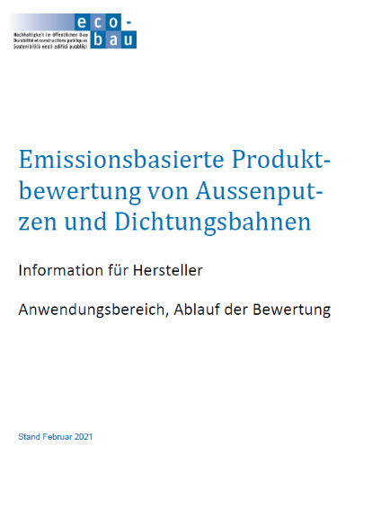
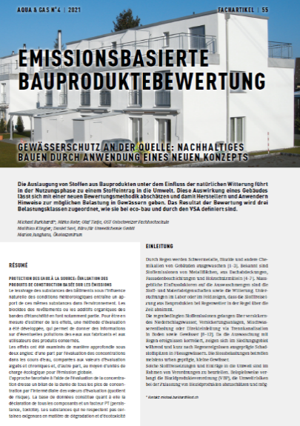
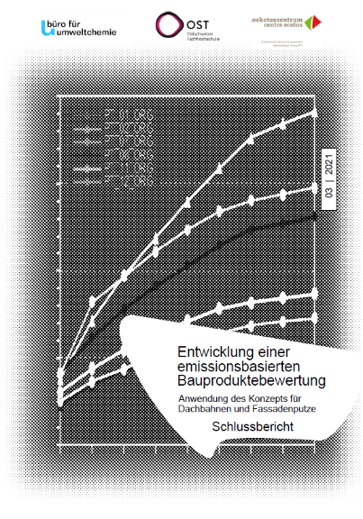


Summary
Leaching at facades occurs under wet weather conditions (peak pollution)
Variability of leaching - potential for product improvements – mitigation measures
Laboratory data can be used for modelling service-life of products with COMLEAM
  In CH, further materials (e.g. wood paints, coated metals) will be evaluated
Easy to handle COMLEAM by batch-simulation (rapid, low costs)
Various European scenarios can be defined for COMLEAM
In Press

Slide 21
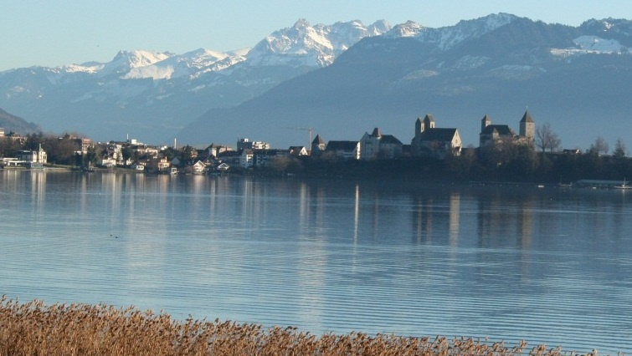
Einstellungen - Aufgaben
Thank you for your attention!
E- Mail: michael.burkhardt@ost.ch

Slide 22
Modelling biocides release from buildings to the environment using COMLEAM
Mirko Rohr*, Michael Burkhardt*, Michael Patrick*, Silvan Gehrig, Olaf Tietje
Eastern Switzerland University of Applied Sciences,
*Institute of Environmental and Process Engineering (UMTEC),
8640 Rapperswil, Switzerland
Online, 4 May 2021

Slide 23

Outline
Introduction
Façade Coatings
Risk Scenario
COMLEAM-Software
Exercises

Slide 24
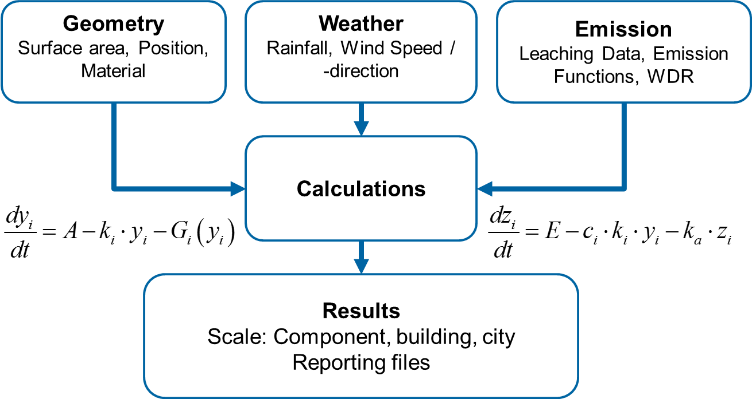
COMLEAM Software: Modelling Emissions to the Environment
Construction Materials Leaching Model (COMLEAM, www.comleam.ch )
  User-friendly interface
  Settings individual or predefined
  Standardized reports
  Manual (V 3.0)
  Online or offline, freeware
Model structure
  Module “Geometry”
  Module “Weather”
  Module “Emission”

Slide 25
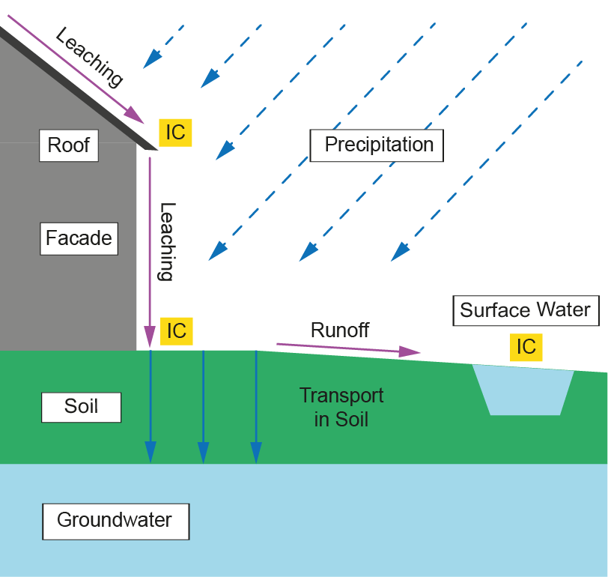
COMLEAM Software: Modelling Leaching and Environmental Exposure
System Boundaries
  Leaching of substances from buildings (roof, façade, etc.) to surface waters
  Point-of-interest are “interface compartments” (IC)
Calculation Methods
  Dynamic simulation with a temporal resolution of substance release and occurrence (hourly resolution)

Slide 26
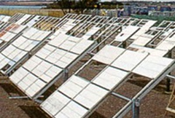
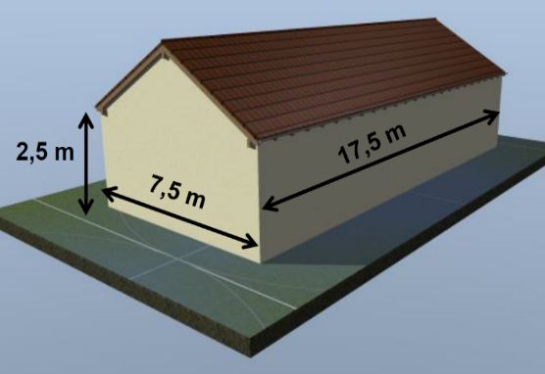
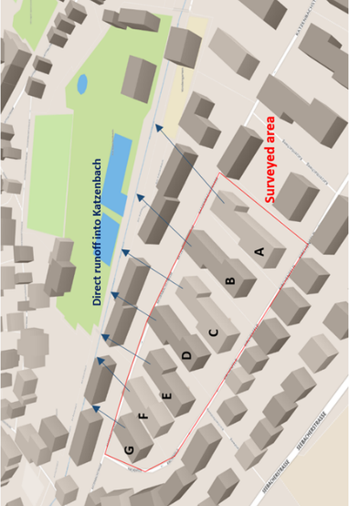
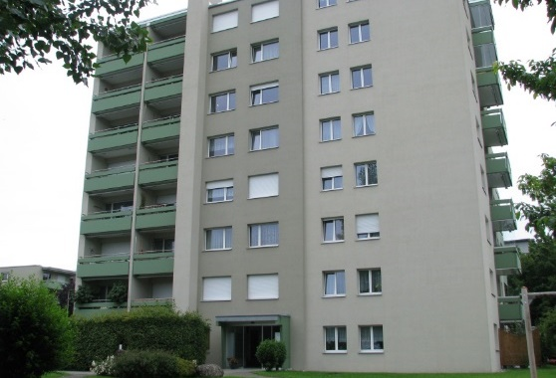
COMLEAM Software: Module “Geometry”
Geometry file
  Vertical and horizontal components of buildings
  Size: height, length, orientation (°)
  Linked to “building materials”
Relevance for leaching
  Initial amount of substance
  Substance-free areas resulting in dilution
  Façade orientation is affecting runoff amount
  Wall factor reflects building heights (WDR)
Component
BPR-House
Apartment
City

Slide 27
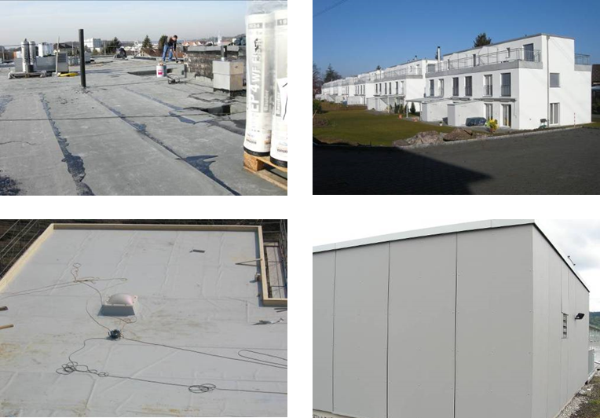
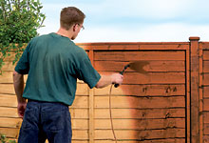
COMLEAM Software: Building Material
Building material
  Materials: Render, paint, polymer membrane etc.
  Substances: Terbutryn, DCOIT, Zinc, etc.
  Initial concentration: amount applied (mg/m²)
  Runoff coefficient ψ: Water losses by splashing, absorption, evaporation
Relevance for exposure
  Emission is based on a specified substance
  Environmental risk is related to leaching behavior and amount of substance
Biocide | Solubility (mg/L) | logPow | Persistence
Terbutryn | 22 | 3.7 | high
Diuron | 35 | 2.7 | high
Isoproturon | 70 | 2.5 | high
DCOIT | 14 | 4.9 | medium
OIT | 480 | 2.4 | low
IPBC | 168 | 2.4 | low
Carbendazime | 8 | 1.6 | medium
Zinc pyrithione | 8 | 0.9 | medium

Slide 28
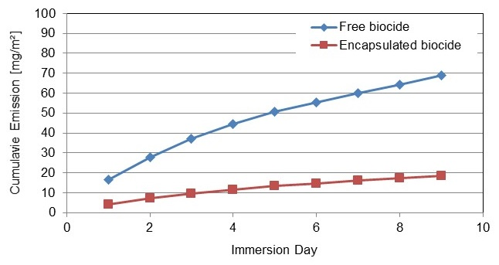
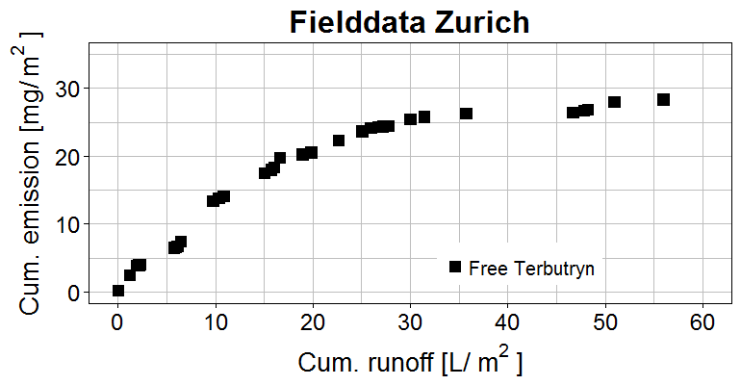
COMLEAM Software: Module “Emission”
Use of leaching data
  Measured runoff [L/m²] and emission [mg/m²]
  Emission function derived automatically by non-linear regression
  Log-function with best fit (Tietje et al, 2018)
Relevance for exposure assessment
  Up-scaling from specimen to buildings and catchments
  Long-term emissions (service-life)
  Different sites (e.g. European FOCUS-sites)
Lab Data (EN16105 or DSLT)
Field Data

Slide 29
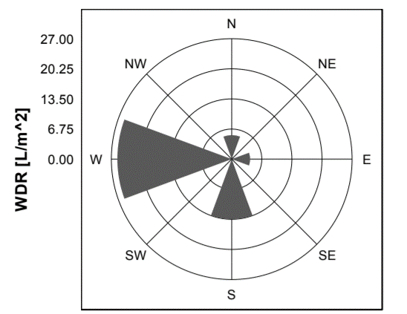
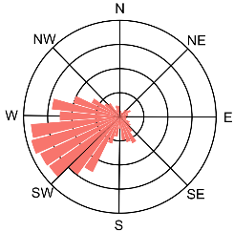
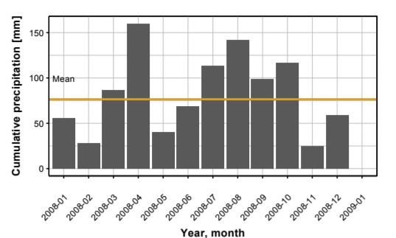
COMLEAM Software: Module “Weather” and Surface Water Compartement
Weather data (hourly resolution)
  Wind direction and wind speed
  Precipitation
Wind driven rain (WDR, ISO 15927-3:2009), e.g.
  Orientation (E, W, N, S)
  Height of building
  Position to other buildings
Receiving surface water
  Class S: < 0.1 m³/s (<8.6 m³/d)
  Class M: 0.1 – 1 m³/s
  Class L: > 1 m³/s (>86 m³/d)

Slide 30
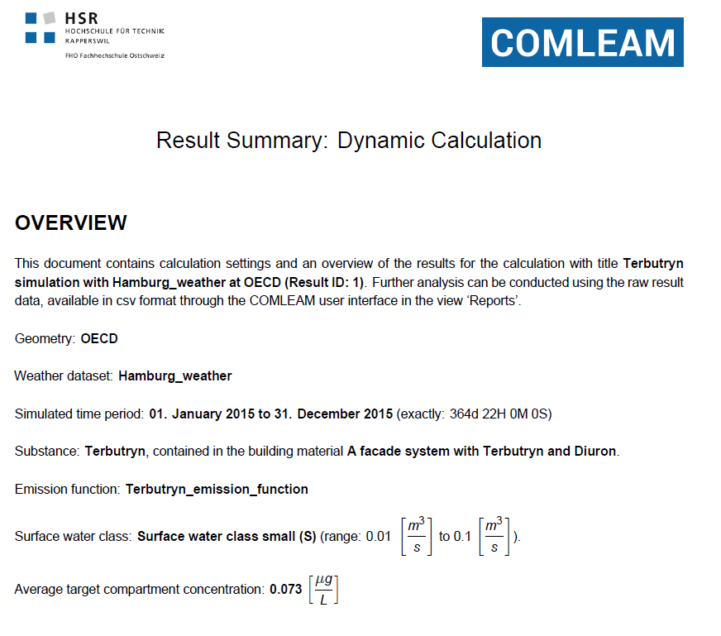
COMLEAM Software: Standardized Simulation Output
Reporting document (ca. 13 pages)
  Summary of all simulation settings and results
  Standardized PDF-document
  Get the report by “Download Report”
Output data
  Containing all information of the simulation
  Useful for individual data processing
  Import file for other compartment models
  (e.g. PELMO, PEARL)
  Get the data as .csv-files by “Download Data”

Slide 31
COMLEAM Software: Summary
Dynamic simulation of leaching from construction materials, buildings and cities using lab/field data and occurrence of substances in surface waters
  Reflecting real conditions and environmental risk over service-life (e.g. 20 years)
Initial scenarios are prepared and tested – EU scenarios can be prepared
  Default values set and benchmark data provided (beneficial for product classification)
Open platform for “creative” simulations or evaluation of reduction measures
  Coupling to 3D-GIS, soil models or hydrological models of sewer networks
Users of authorities, industry and sciences are supported for free of charge
  Technical support is guaranteed (www.comleam.ch)

Slide 32
Outline
Introduction
Façade Coatings
Risk Scenario
Summary
COMLEAM-Software
Exercises

Slide 33
Exercise – Modelling with COMLEAM
Simulation of a render applied on a single standard house
  Leaching from facades to surface water
  Calculate concentrations in surface water
  Calculating risk quotient (RQ, PEC/ PNEC-ratio) for acute and chronic quality criteria
First, Input parameters and data are defined (1 weather data, 2 geometry, 3 materials, 4 substances, 5 emissions)
Secondly, calculation are started and results summarized in a report
Link: https://sw.comleam.com

Slide 34

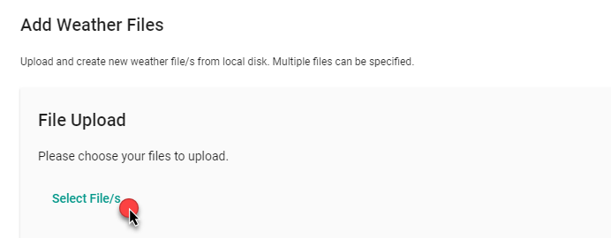
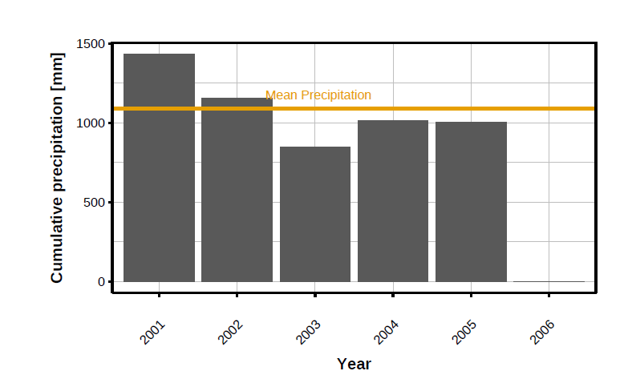
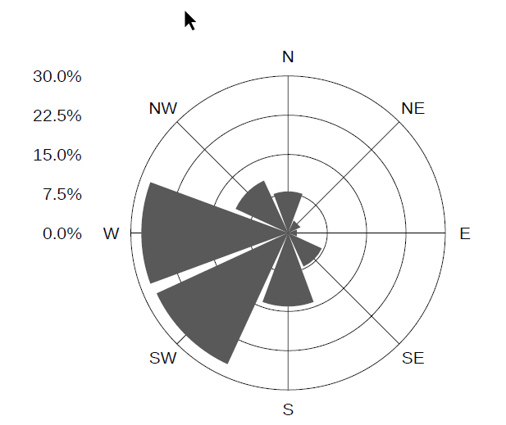
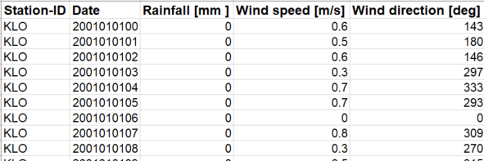
1 Weather Data
Weather data (in general)
  Data of commercial station (e.g. DWD) or own data
  Precipitation, wind speed and wind direction
  Full data series needed (no missing time stamps)
  Weather data of Hamburg, Munich, Sevilla, Zurich implemented
Weather data used for the simulation
  Zürich 01.01.2000 – 01.01.2006

Slide 35
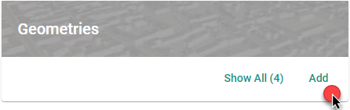
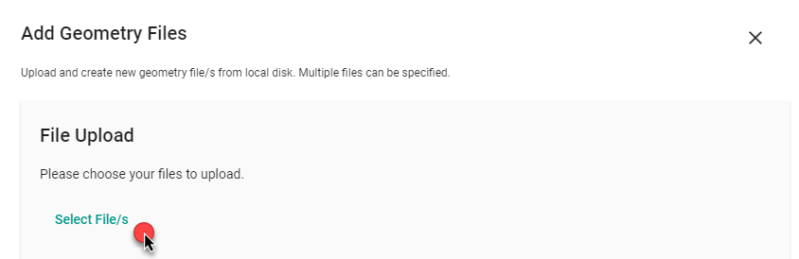


2 Geometry
Geometry file (in general)
  Single apartment, house, city
  Building components (1….n)
  Components represent horizontal (e.g. roof, pavement) or vertical surfaces (2.g. façade, wall)
  Size and Orientation: Height, length, area, exposition (°)
  Linked to "building materials"
Geometry used for the simulation
  Standard House of Biocidal Product Regulation (BPR)
  Different adaptions, e.g. 10 m height instead of 2.5 m

Slide 36


3 Materials
Building materials (in general)
  Material type (render, paint, polymer membrane etc.) and subtype (render matte, polymeric render etc.)
  Runoff coefficient defined per subtype
  Substance (Terbutryn, Carbendazim, etc.) with initial concentration (mg/m²)
  Material in geometry files identified over a 3- or 4-digit code
Building Materials used in simulation
  Facades with 100 % render and runoff coefficient 0.7
  Biocides Diuron and Carbendazim
  Roof without substance release and runoff coefficient 1.0
  (no biocides, only dilution)
  Area of dilution without substance release and runoff coefficient 1.0
  (no biocides, only dilution)

Slide 37





3 Materials

Slide 38



4 Substances
Substances in building materials (in general)
  Biocides, anti-Root penetration agents (e.g. Mecoprop, MCPA), flame retardants (e.g. TBEP, TCPP, HBCD), plasticizers (e.g. DIDP, DEHP) or heavy metals
  Substance identified via EC or CAS number
  Acute and chronic quality criteria for each substance
  Substances are linked to "building materials" and "emission functions"
Substances used for the simulation
  Diuron: acute value 0.25 µg/L; chronic value 0.07 µg/L
  Carbendazim: acute and chronic values 0.1 µg/L (default value)
Terbutryn
Diuron
Carbendazim

Slide 39


4 Substances
1
2
3
Diuron
Carbendazim

Slide 40



4 Substances

Slide 41


5 Emissions
Emission Data (in general)
  Leaching results of lab tests (EN16105, EN 16627-2) or field tests
  Results based on cumulated runoff [L/m²] and cumulated emission [mg/m²]
  Parametrization of leaching data to derive an emission function by non-linear regression (nls). COMLEAM offers 'best fit' or user defines individually
Leaching data used for simulation
  Immersion Test (EN 16105) of polymeric render product with Diuron and Carbendazim
  Test conducted within a Swiss study
Test specimen of immersion test (EN 16105 - coatings)
Gutter collecting facade runoff in the field

Slide 42



5 Emissions

Slide 43


6 Calculations

Slide 44

6 Calculations

Slide 45

6 Calculations

Slide 46

6 Calculations

Slide 47

6 Calculations

Slide 48
6 Calculations

Slide 49

6 Calculations
CT Topography factor describing the terrain topography
O Obstruction factor describing wind driven rain due to obstacles

Slide 50

6 Calculations

Slide 51

6 Calculations
Flow factor kv: describing the interval per day the linear compartment is emptied
Q347: Flow in average at 347 days of the year

Slide 52

7 Results / Report
Reporting document (13 pages):
  Summary of simulation settings and results
  Standardized PDF-document
  Get the report by "Download Report"
Output data
  Contains all information of the simulation
  Useful for data processing
  Import file for other compartment models (e.g. PELMO, PEARL)
  Get the data as .csv-files by "Download Data"
Example for Diuron

Slide 53


7 Results / Report
Wind driven rain amount by heading [L/m²]
  Most wind driven rain from West
Cumulative wind driven rain by façade orientation [L/m²]
  50% of cumulated wind driven rain at the West façade

Slide 54




7 Results / Report
Cumulative Runoff [L] from façades
  70% of runoff from West façade (ca. 16'000 L)
Cumulative Emission [mg] from façades:
  60% of emissions from West façade (ca. 5 g)

Slide 55


7 Results / Report
Concentration [µg/L] in runoff from building:
  Runoff from façade is diluted by runoff from roof and pavement (400 m²)
Concentration [µg/L] and exceedances in the environmental compartment:
  Acute: 3 exceedances, total duration 37 h
  Chronic: 63 exceedances, total duration 1331 h

Slide 56




8 Risk Evaluation of Chemical Mixture
Risk Quotient for single substance
(acute, chronic)
RQ_{i} $= \frac{Predicted Environmental Concentration \left(PEC\right)}{Environmental Quality Standard (EQS)}$
Risk Quotient for mixed toxicity
RQ_{mix} $= \sum_{i}^{n}{RQi}$

Slide 57
Einstellungen - Aufgaben
Thank you for your attention!
E- Mail: michael.burkhardt@ost.ch

